Slide 1
Chapter 7
Manipulating the Camera

Slide 2
This Chapter
Make the camera easier to work with
Define default manipulation functionality
Interpolate values to support smooth transitions
Use of math in describing behaviors
Program with multiple views
Already know this
Transform between Canvas (Device) Coordinate to World Coordinate
Support mouse input

Slide 3
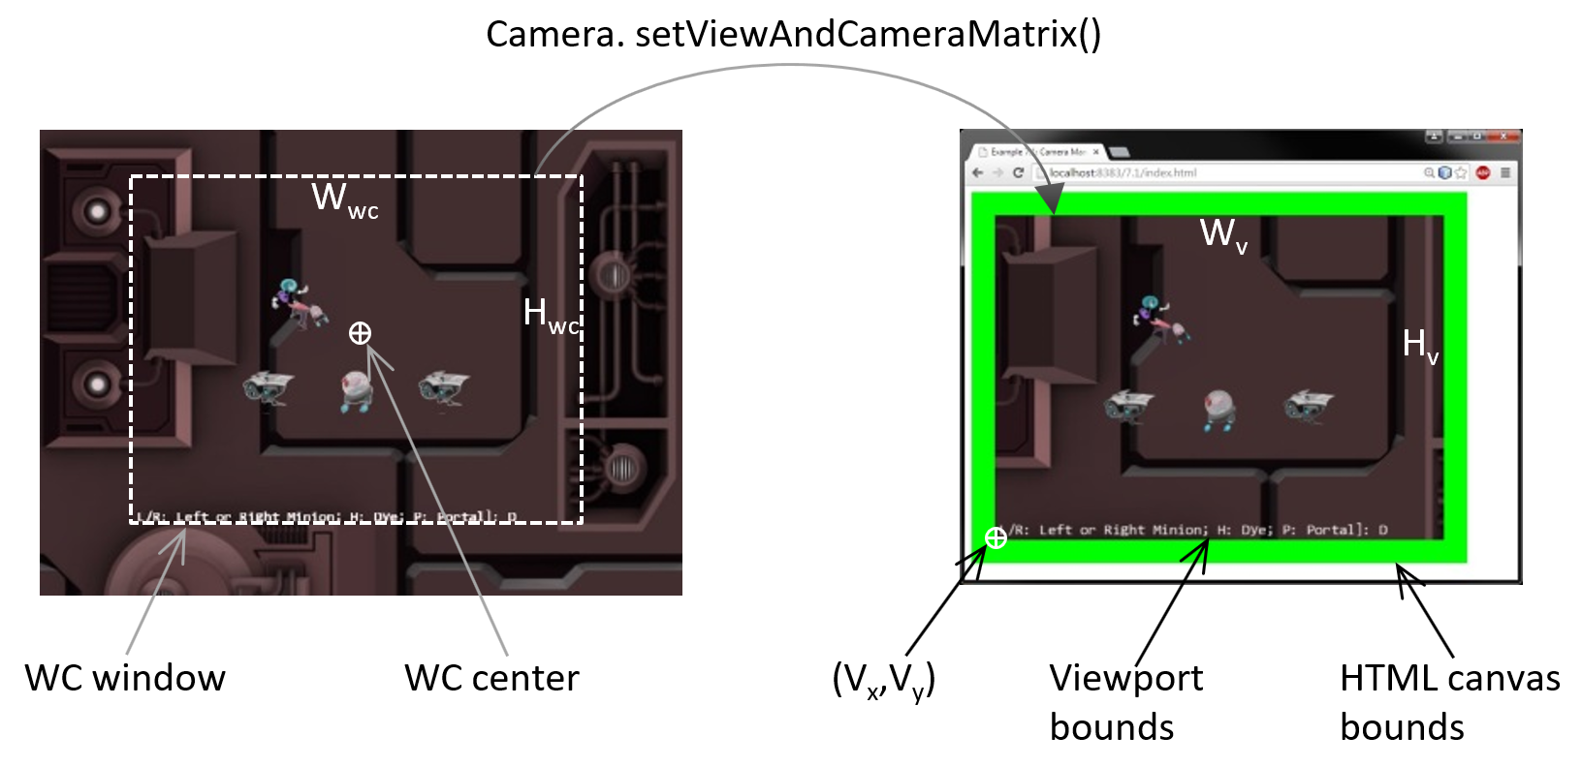
Review
Encoded in the Camera matrix

Slide 4
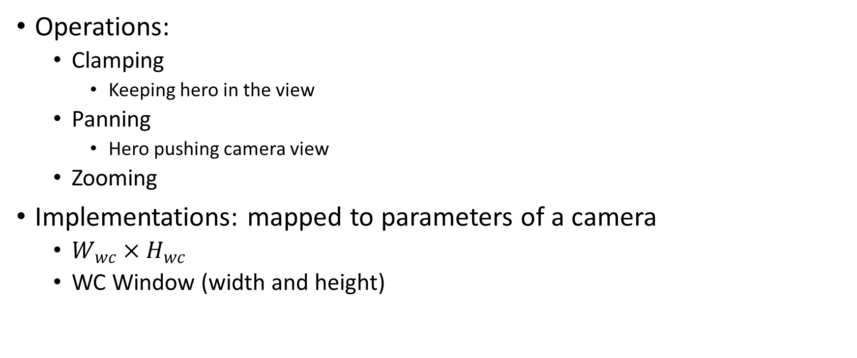
Camera Manipulations
Operations:
Clamping
Keeping hero in the view
Panning
Hero pushing camera view
Zooming
Implementations: mapped to parameters of a camera
$W_{wc}×H_{wc}$
WC Window (width and height)

Slide 5
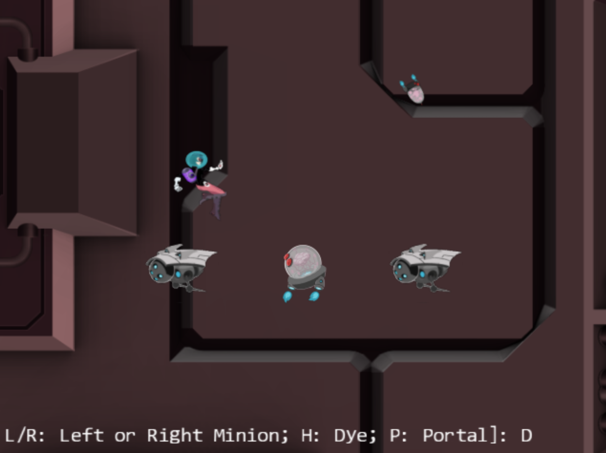
7.1: Camera Manipulations Project

Slide 6
7.1: Goals
Experience common camera manipulation operations
Understand the mapping from manipulation operations to camera parameters
Implement the manipulation operations

Slide 7
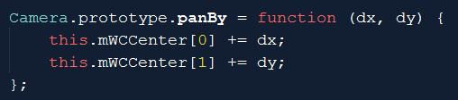
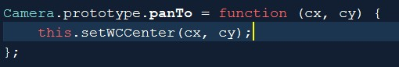
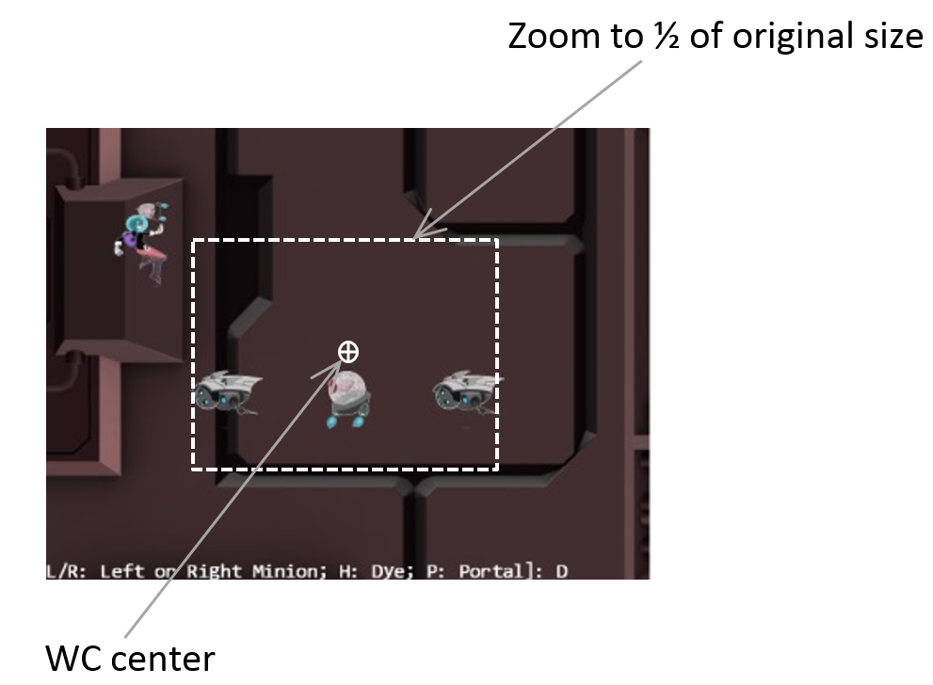
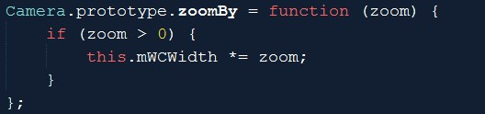
camera_manipulation.js: operations
Translate WC window
Zoom with respect to center

Slide 8
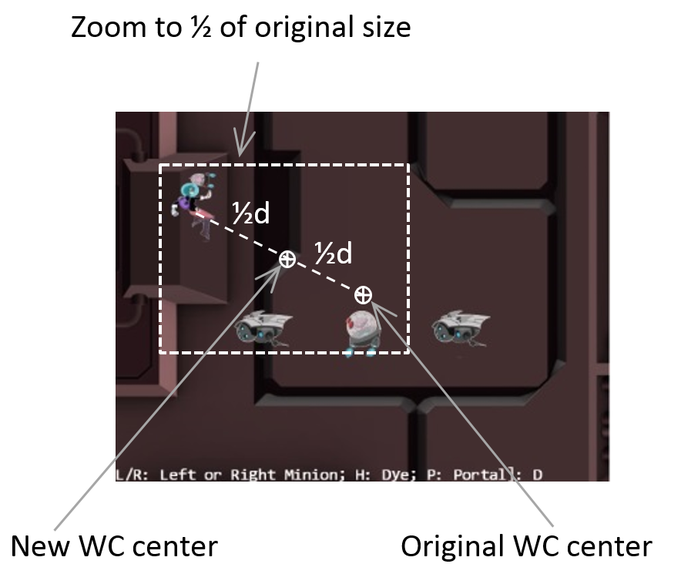
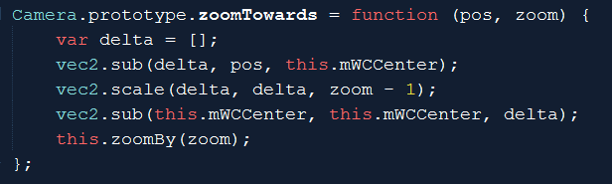
Zoom towards a fix location
Zoom wrt pos (Dye)
Delta: from wcCenter towards pos
If zoom > 1
wcCenter moves away from pos (see more world)
If zoom < 1
wcCenter moves towards pos (see less world)
After moved wcCenter, change wcWidth as usual
delta: from wcCenter towards pos

Slide 9
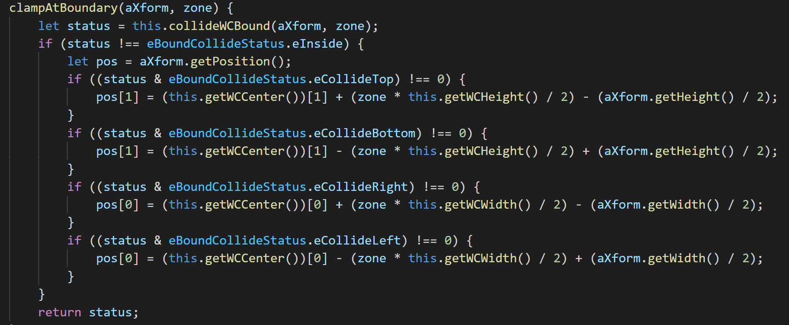
Clamp Obj (xform) to Camera WC Bounds
camera_main.js

Slide 10
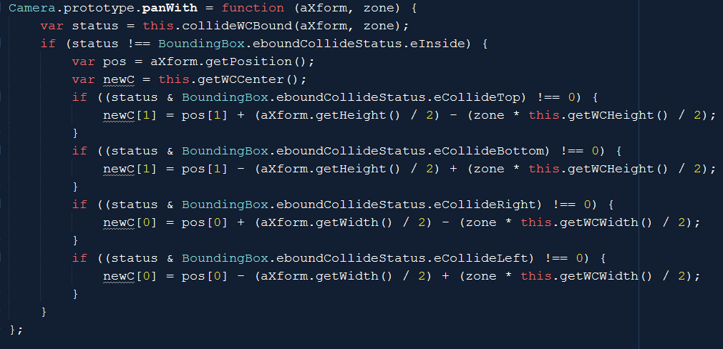
Opposite of clamp: Pan Camera with Obj
camera_manipulation.js

Slide 11
Testing:
WASD: move hero to pan camera (90%)
Arrow: move portal clamped (80%)
L/R: Camera pan to Left/Right
N/M: Zoom wrt center
L/R/P/H: Select Left/Right/Portal/Hero
J/K: zoom wrt to selected position
Put finger over selected object and zoom
Object does not change relative position

Slide 12
Powerful functionality, bad user experience
Sudden changes resulting from manipulation (e.g., panTo())
May seem incoherent (whole world jumped)
Gradual changes (in real life) would be nice

Slide 13
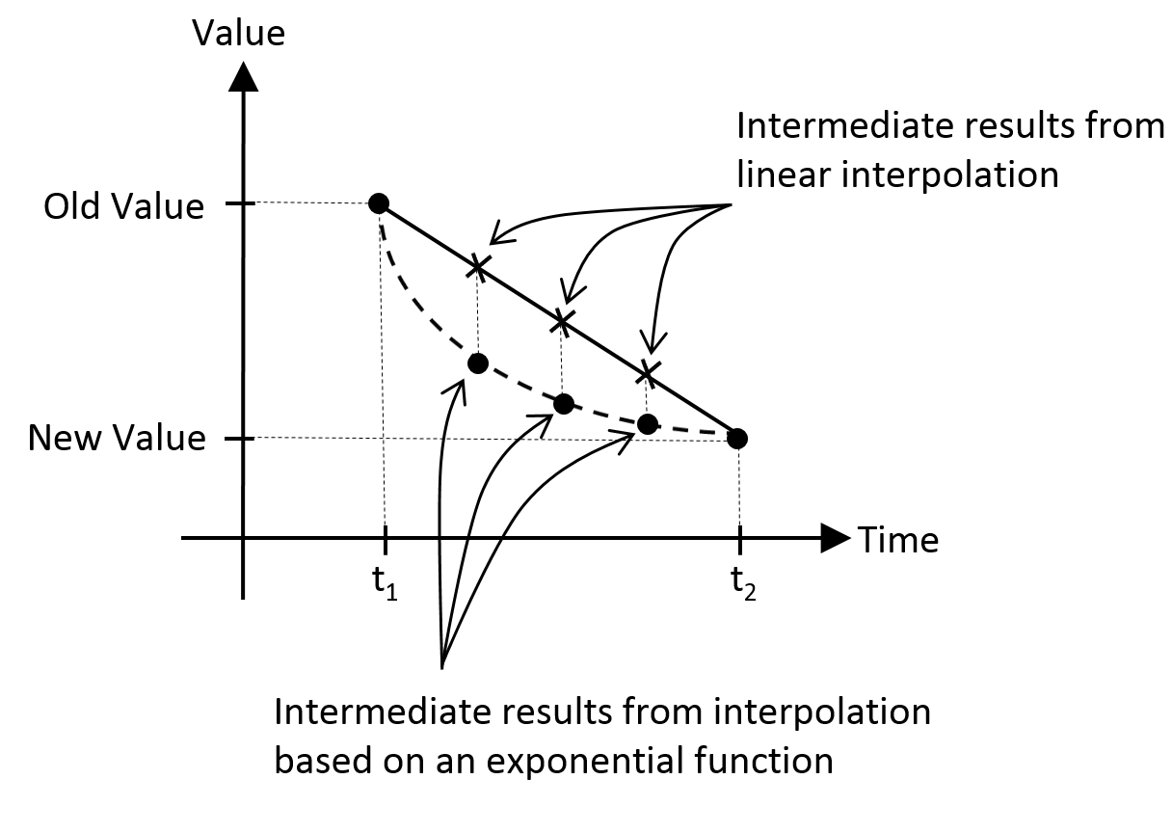
Need for interpolation
Gradual change of values: over time in this case
Example: two types of interpolations
Linear: change with fix rate
Exponential: change based on ratio of current value (our turn towards function)

Slide 14
7.2: Camera Interpolation Project

Slide 15
7.2: Goals
Understand and work with interpolated results
Implement interpolation to support gradual camera parameter changes
Understand keys to implementing interpolation
Keeping track of and separating: current from final values
Support access to current values
Need update() to trigger interpolation computation to take current value closer to final value

Slide 16
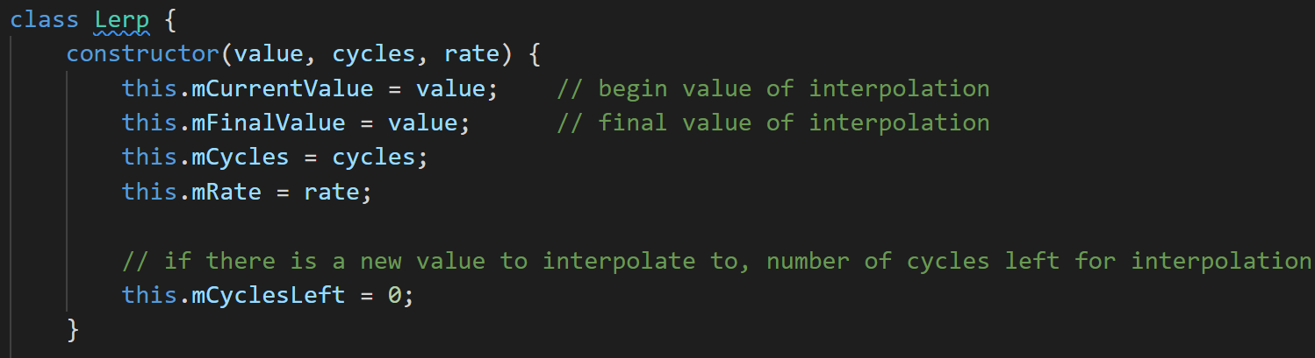
lerp.js: A Utility
From: mCurrentValue, Change to: mFinalValue
In: mCycles, changes at mRate
mCyclesLeft: keeps track of how many left

Slide 17
Interpolate.js: get/set/configure
get() current interpolated result
setFinal()
triggers new interpolation
config(stiffness, duration)
Stiffness: how quickly values change
1 is no lerping (sudden change), 0 is does not change at all
Duration: how long to change from initial to final

Slide 18
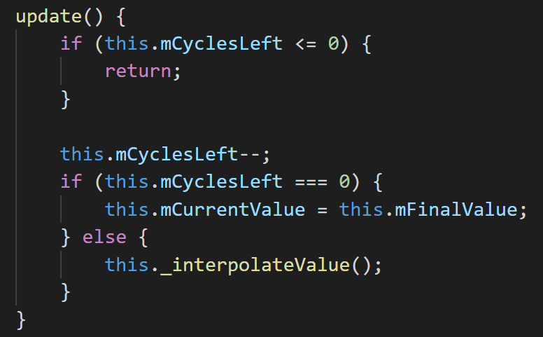
lerp.js: compute intermediate value
If cycles left compute
Each iteration:
linearly changing from current to final
Overall: exponential function from initial to final

Slide 19
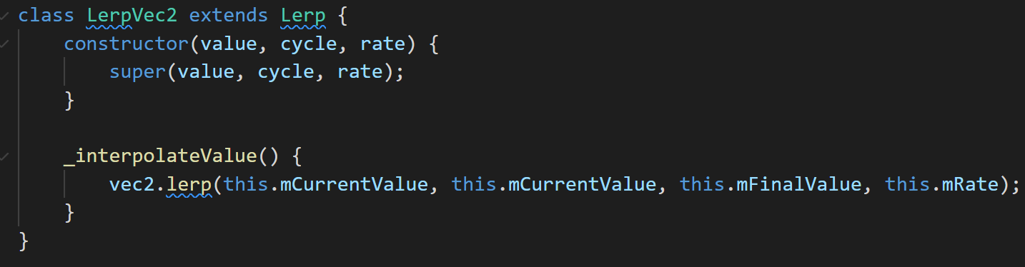
Lerp_vec2.js
Need to interpolate vec2 objects!
vec2.lerp() implements the same Lerp::_interpolateValue()
For each of the x/y components

Slide 20
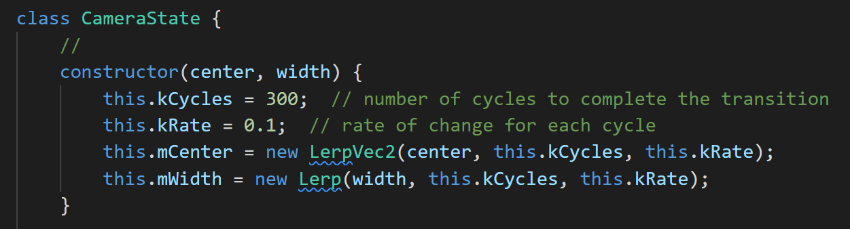
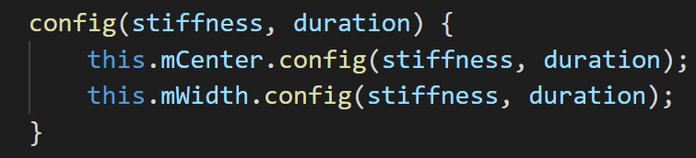
camera_state.js: current and final values
Notice the references to: LerpVec2 and Lerp
Configuration:
Must call update()!!

Slide 21
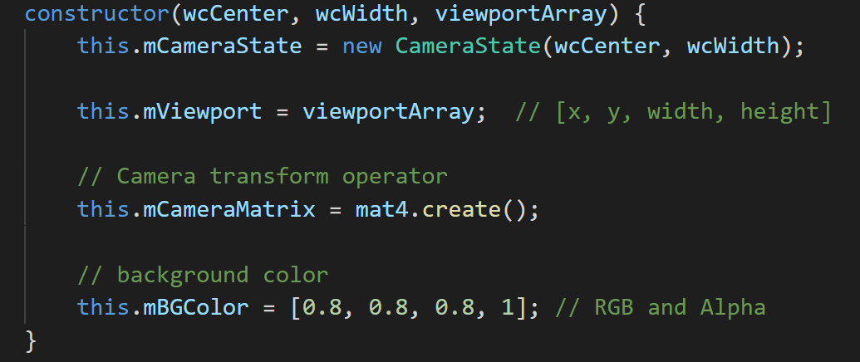
Integrate CameraState
Camera only reference to CameraState
All set/get to wcCenter and wcWidth now refers to CameraState

Slide 22
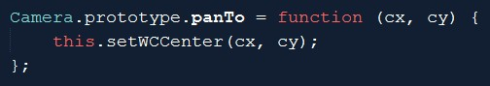
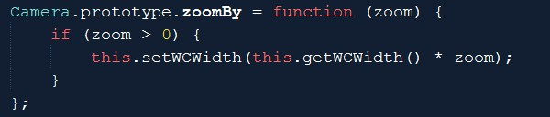
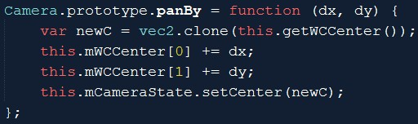
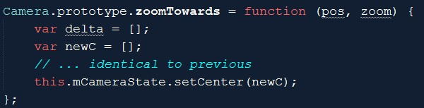
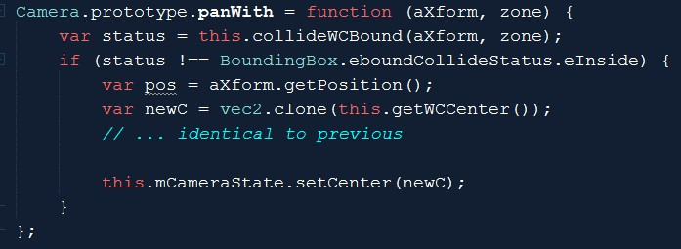
Camera manipulation: to CameraState

Slide 23
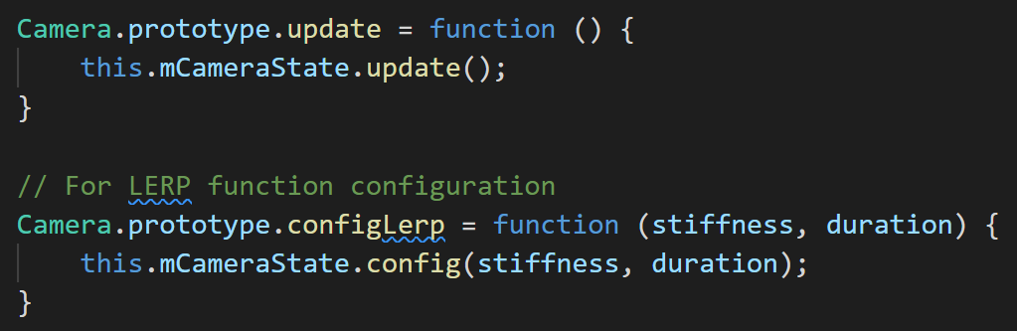
camera_manipulate.js: update + config
MUST call Camera.update()!!

Slide 24
Testing interpolated manipulation
Notice the much smoother transitions
MyGame.update() → calls camera.update()!!
Stiffness:
Large values (e.g., 0.8, or 0.9):
degenerates to sudden changes
Very smaller values (e.g., 0.01):
Slow motion effect
Duration:
Very large values (e.g., 500)
Seems to never reach stable value (tiny movements towards the end)
Very small values (e.g., 10)
Unable to complete the function smoothly
Degenerates to sudden jumps at the end

Slide 25
Shaking the camera
Interesting way to convey “SOMETHING IMPORTANT” has occurred
Boss appear/defeated
Large object collision
Parallel goal: examine another example of controlling with math
Reflection of real-life example
Aiming the camera and knocked off the target
Retargeting: Return “quickly”, and adjust to stop at target

Slide 26
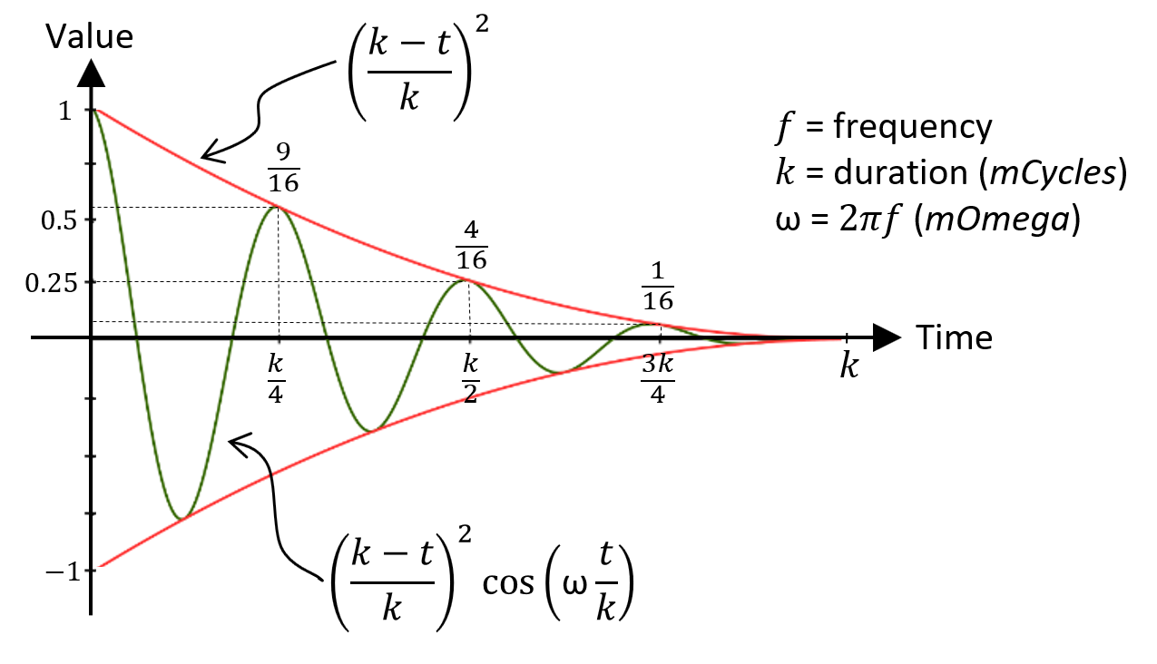
Damped Harmonic Motion

Slide 27
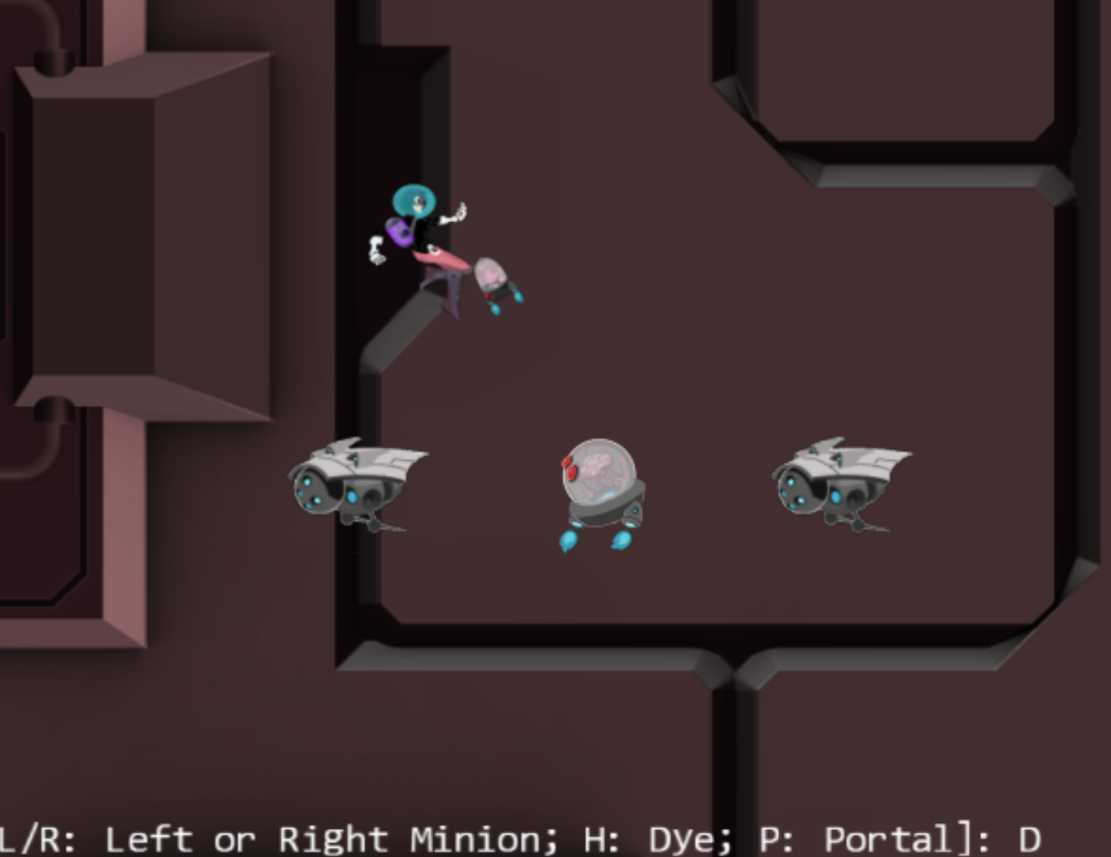
7.3: Camera Shake and Object Oscillate Project

Slide 28
7.3: Goals
To gain some insight into modeling displacements with simple mathematical functions
To experience the object oscillate effect on an object
To experience the camera shake effect on a camera
To implement oscillations as damped simple harmonic motion, and to introduce pseudo-randomness to create the camera shake effect

Slide 29
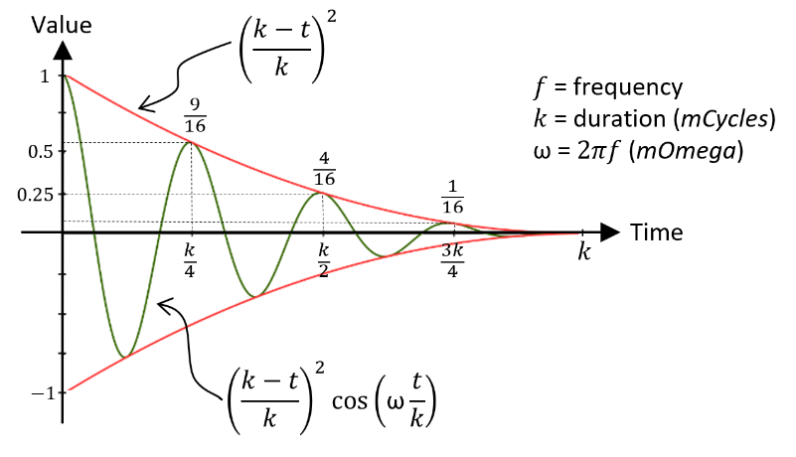
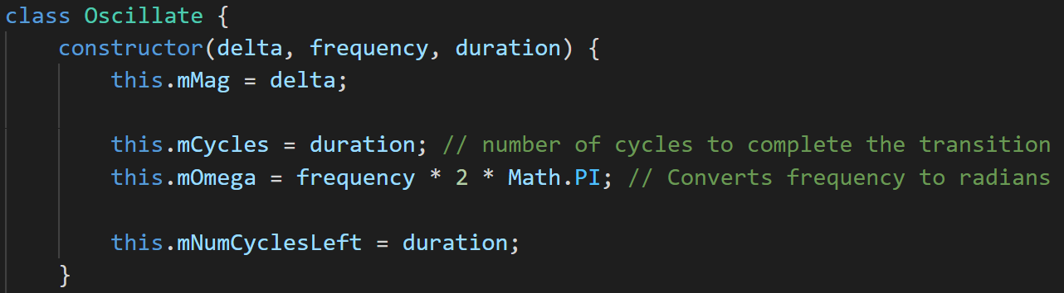
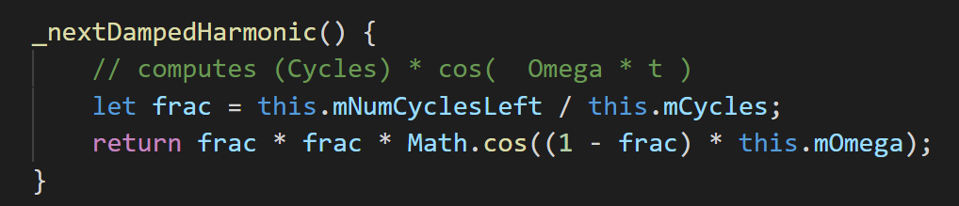
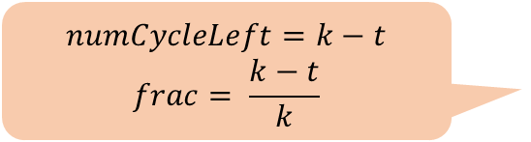
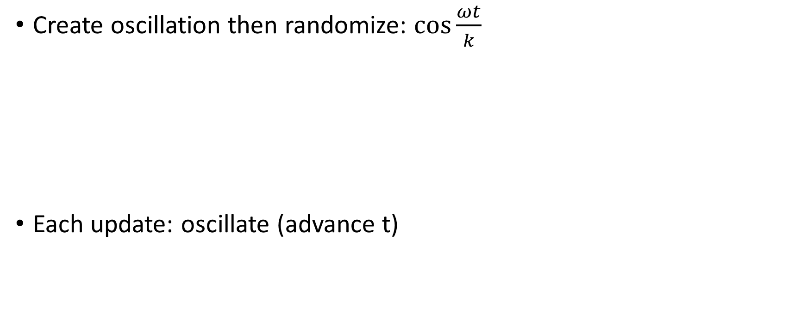
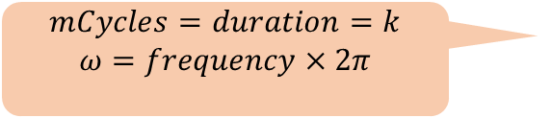
Oscillate: step towards Shake
Create oscillation then randomize: $\cos{\frac{ωt}{k}}$
Each update: oscillate (advance t)
$$mCycles=duration=k$$
$$ω=frequency×2π$$
$$numCycleLeft=k−t$$
$$frac= \frac{k−t}{k}$$

Slide 30
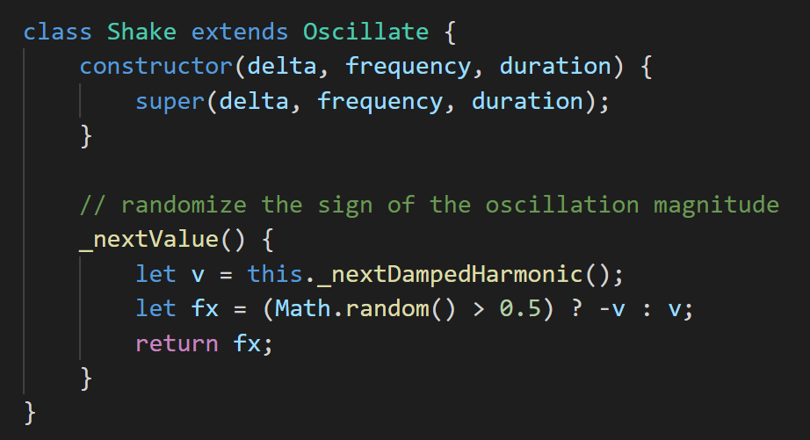
Shake: randomize dampedHarmonic

Slide 31
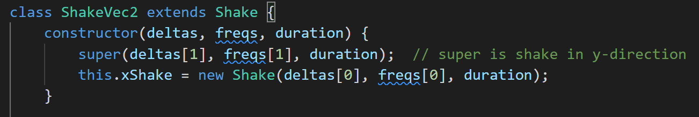
shake_vec2: subclass + an explicit instance
Instance is X, subclass is Y

Slide 32
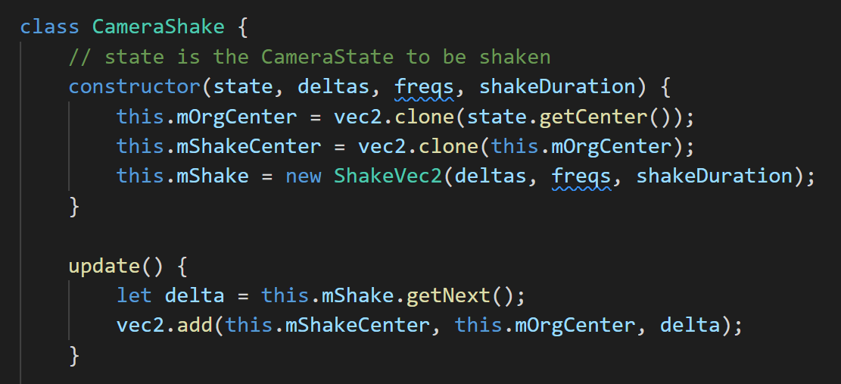
camera_shake.js: Integrate shake into
Shaking the CameraState’s center
Change the center by ShapePosition’s displacement (s)
Adding the offset to the origin (without changing the origin)
Offset becomes smaller over time

Slide 33
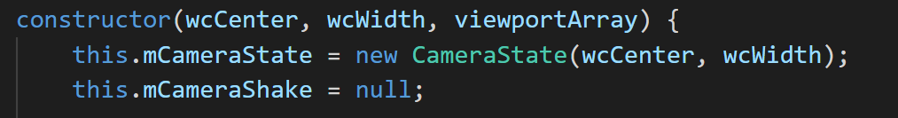
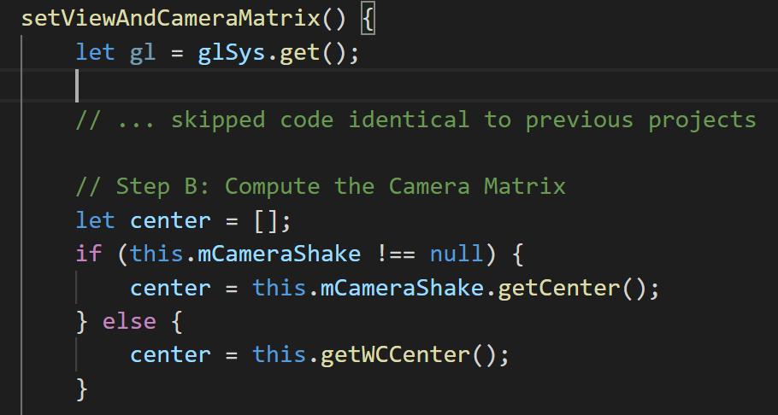
Modify the Camera

Slide 34
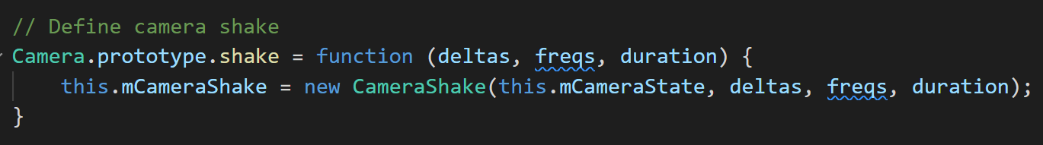
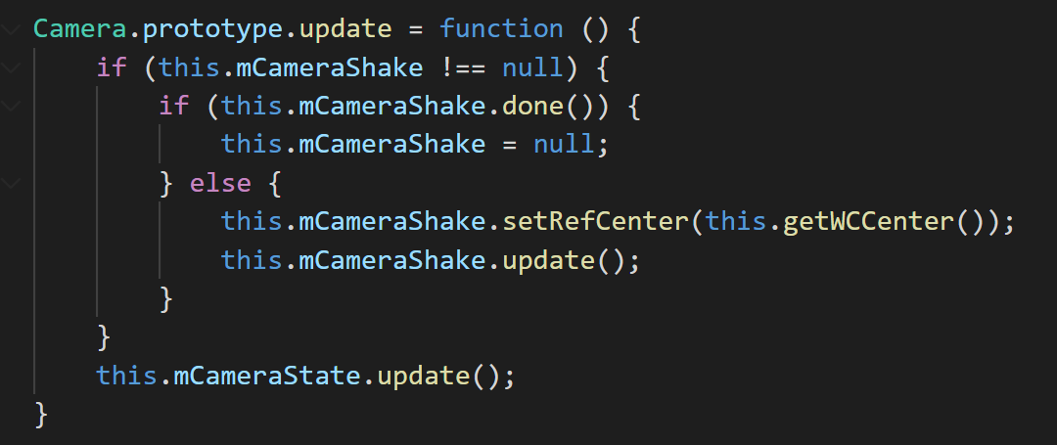
Set and update Shake (Camera_Manipulation)

Slide 35
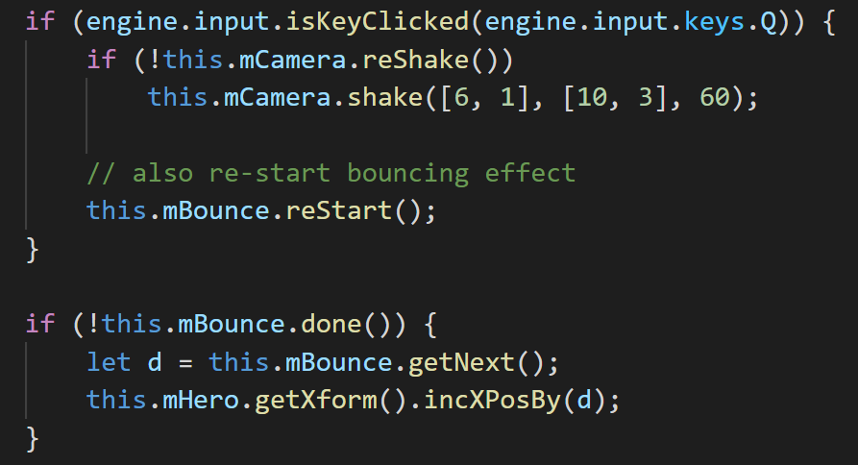
Oscillating the Hero
Create mBound instance in MyGame::init()
MyGame::update()
delta X/Y, frequency X/Y, duration

Slide 36
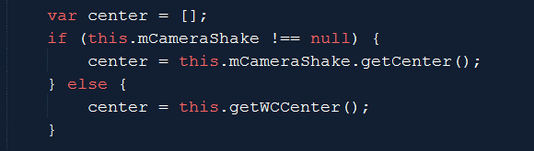
Testing camera shake and object oscillation
xyDelta:
Large (200): earth quake! Small (0.1): can’t see anything!
Frequency:
Only observable with large xyDelta, larger values tend to “softens” the shake
Duration:
Large duration (300): annoying? Short duration (3): subtle, seem like error!
WATCH OUT!
Shake is an offset (to the original value)
Always keep/restore the original value

Slide 37
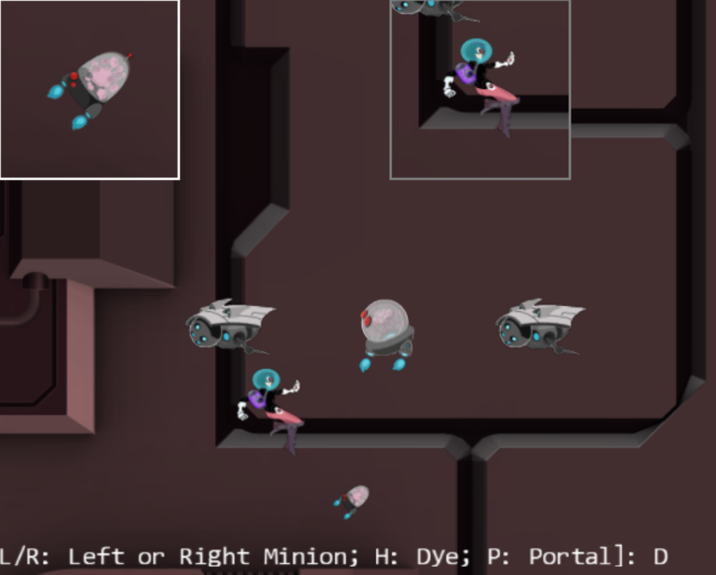
7.4: Multiple Camera and Viewport
We have done this in MPs!

Slide 38
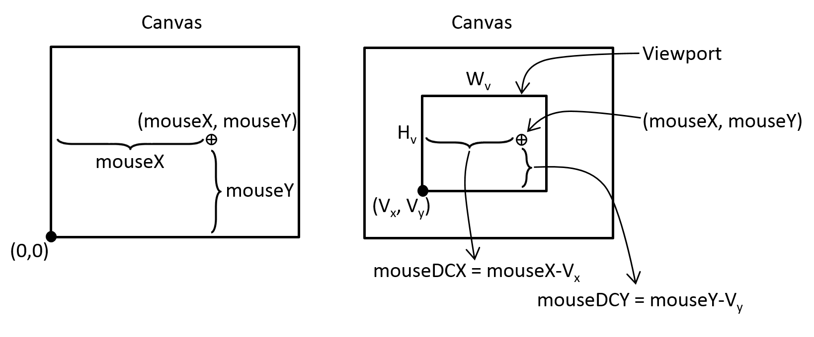
Working with Mouse Input (Selection!)
Mouse positions: Canvas coordinate!
GameObjects are in WC!
Canvas to Viewport

Slide 39
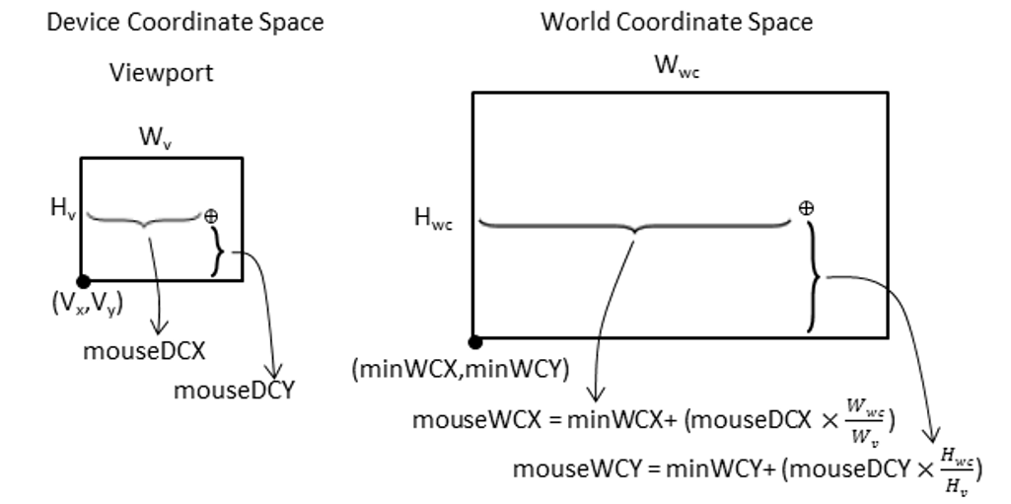
Viewport (device) to World Coordinate!

Slide 40
Questions
My canvas is 1000x800
My camera1: Center(50, 50), Width=100, Viewport:[100, 200, 400, 600]
My camera2: Center(100, 100), Width=10, Viewport: [50, 100, 100, 100]
Sketch my viewports in the canvas
HTML5 reports that a mouse click occurs at: (mouseX, mouseY)
(50, 100): should I care about this?
(300, 400): how about now?
What are the point in DCx, DCy for my two viewports?
What are the points in WCx, WCy for my two cameras?

Slide 41
Questions
My canvas is 1000x800
My camera1: Center(50, 50), Width=100, Viewport:[100, 200, 400, 600]
My camera2: Center(100, 100), Width=10, Viewport: [50, 100, 100, 100]
Sketch my viewports in the canvas

Slide 42
Questions
My camera1: Viewport:[100, 200, 400, 600]
My camera2: Viewport: [50, 100, 100, 100]
HTML5 reports mouse click occurs at: (mouseX, mouseY)
(50, 100): should I care about this?
(300, 400): how about now?

Slide 43
Questions
[100, 200, 400, 600] [50, 100, 100, 100]
(50, 100): should I care about this?
With respect to Orange: DCx = -50, DCy=-100
➔Orange does not care about this point
With respect to Red: DCx = 0, DCy= 0
➔ Red cares about this point (inside Red viewport)
(300, 400): how about now?
With respect to Orange: DCx = 200, DCy=200
➔ Orange cares about this point (in Orange viewport)
With respect to Red: X = 250, Y= 300
➔ Red does not care (outside of Red viewport)

Slide 44
Questions
Viewport: [50, 100, 100, 100]
We know … HTML reports: (50, 100)
In Red DC: DCx = 0, DCy= 0
Now for: WCx, WCy (over the Red DC)
Center(100, 100), Width=10
Lower-left = (100-10/2, 100-10/2) = (95, 95)
So, the following are the same point
Canvas-(50, 100)
DC-(0, 0)
WC-(95, 95)
10
10
(100, 100)

Slide 45
Questions
Center(50, 50), Width=100 [100, 200, 400, 600]
Canvas (300, 400): Orange: DCx = 200, DCy=200
Percent coverage in DC
X = 200 / 400 = 50%
Y = 200 / 600 = 33.33%
Amount in WC
X = 50% * Width = 50% * 100 = 50
Y = 33.3% * Height = 33.33% * 150 = 50
WC: Lower-left = (50-100/2, 50-150/2) = (0, -25)
WCx, WCy = (50, 25)
100
(50, 50)
150

Slide 46
Summary
Center(50, 50), Width=100 [100, 200, 400, 600]
Canvas (300, 400): Orange: DCx = 200, DCy=200
Percent coverage in DC
X = 200 / 400 = 50%
Y = 200 / 600 = 33.33%
Amount in WC
X = 50% * Width = 50% * 100 = 50
Y = 33.3% * Height = 33.33% * 150 = 50
WC: Lower-left = (50-100/2, 50-150/2) = (0, -25)
WCx, WCy = (50, 25)
DCx = mouseX – ViewportOrgX
WCx = LLx + WC-Width * DCx / ViewportWidth
LLx = lower-left-x = Camera-X – (WC-Width / 2)

Slide 47
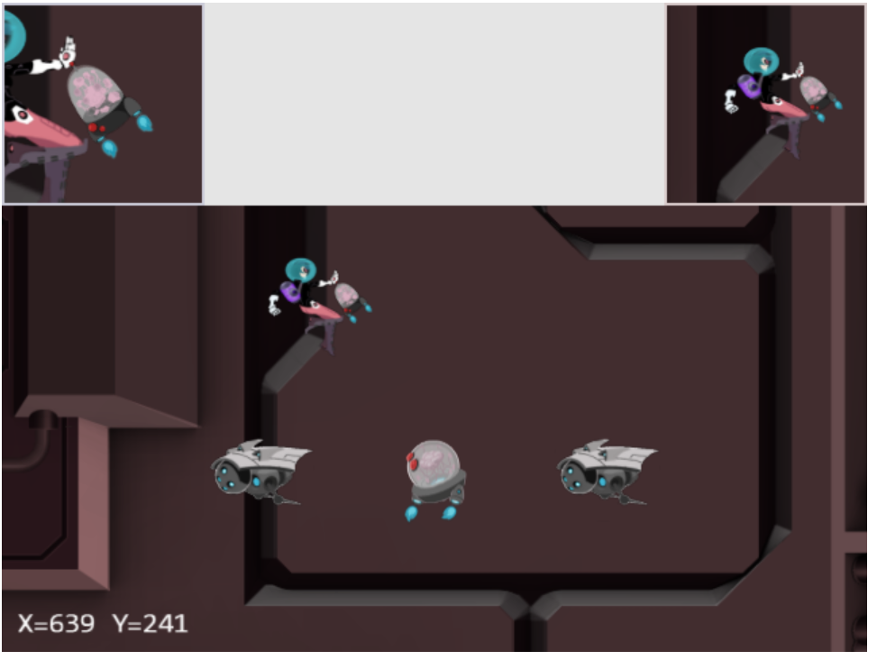
7.5: Mouse Input Project
LMB in main view:
Drags the Portal object
MMB the HeroCam view:
Drags the Hero object
RMB or MMB in any view:
Hides/shows the Portal

Slide 48
7.5: Goals
To understand the Canvas Coordinate space to WC space transform
To appreciate mouse clicks are specific to individual viewports
To implement transformation between coordinate spaces and support mouse input

Slide 49
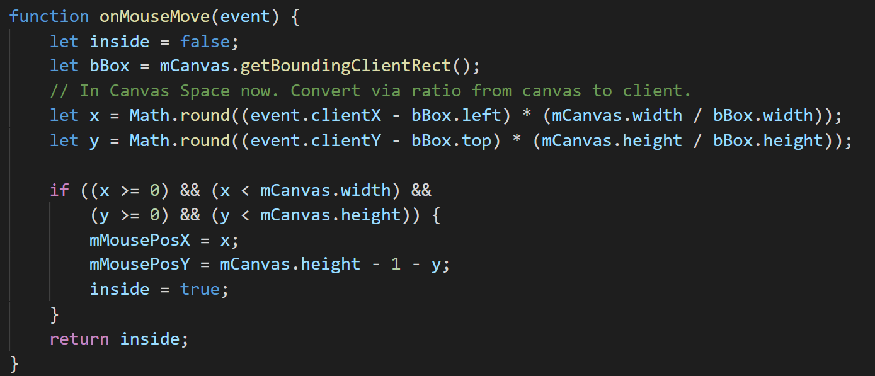
engine/input.js
Needs acces to the Canvas
For mouse click position computation
Arrays: to support left/mid/right
Press/Click (just like keyboard)
Event services: onMouseUp/Down/Move
Register with HTML5 during init
Convert from WebBrowser coordinate into Canvas coordinate
mMousePosX/Y: In canvas coordinate
Access functions: getMousePosX/Y

Slide 50
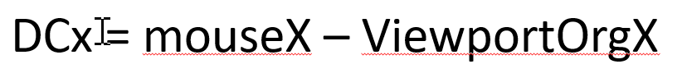
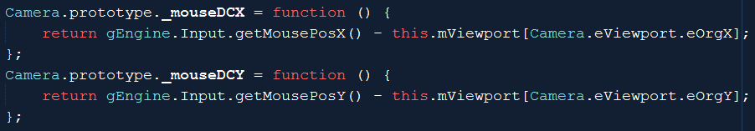
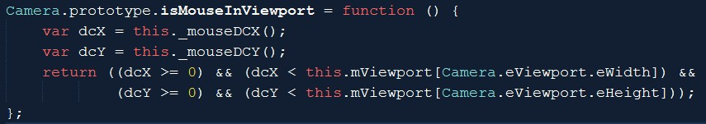
camera_input.js: Canvas to DC
DC is Viewport’s coordinate
If mouse click is in the viewport of a camera

Slide 51
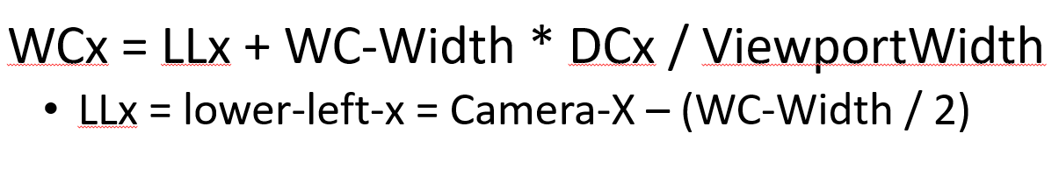

Camera_Input.js:: DC to WC

Slide 52

MyGame.update(): Testing Mouse Input
Examine dcXY:
Test button clicks:

Slide 53

MyGame::update(): Testing Mouse Input
Test WC coordinate value and Button pressed (draggin)
Note: isMouseInViewport() function call!

Slide 54
Mouse input: notice
Can differentiate mouse click by viewport (camera)
The actual interaction code should be hidden from MyGame
Define a MyCamera to subclass from Camera
Implement mouse events in MyCamera.update()
Right-mouse-click
Browser hijacked this event!

Slide 55
Chapter 7: Learned
Camera manipulation:
Manipulation of wcCenter, wcWidth
Either change GameObject, or change camera values
Math operation/expression
For controlling smoothness
For controlling movement
Positional input device (mouse)
Ability to support multiple views
Coordinates:
Canvas, Viewport (DC), World
Image (pixels), UV (texture),
NDC

Slide 56

7.6: You can draw lines! ☺

